Slide 1
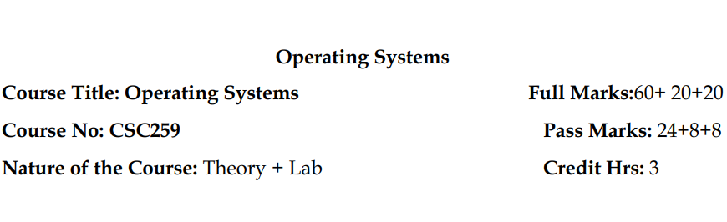

Slide 2
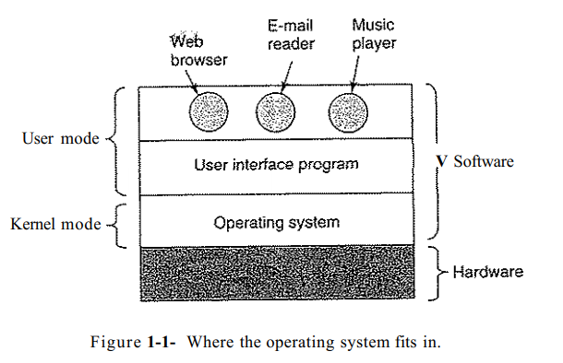
What is operating system?
It is the software that runs in kernel mode.
An operating system is a program that acts as an intermediary between a user of a computer and the computer hardware.
The purpose of an operating system is to provide an environment in which a user can execute programs.
The primary goal of an operating system is thus to make the computer system convenient to use.
A secondary goal is to use the computer hardware in an efficient manner.
Some examples of operating systems are UNIX, Mach, MS-DOS, MS-Windows, Windows/NT, OS/2 and MacOS.

Slide 3
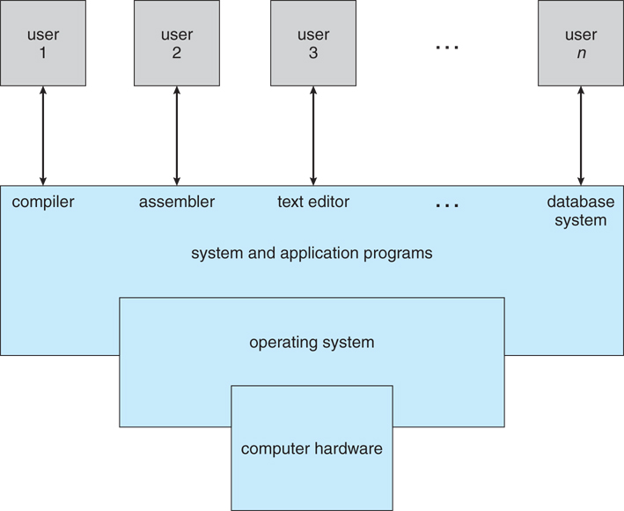
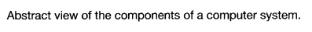

Slide 5
Two views (roles) of operating system
The Operating System as an Extended Machine
The Operating System as a Resource Manager

Slide 6
The Operating System as an Extended Machine
The job of the operating system is to create good abstractions and then implement and manage the abstract objects thus created.
Due to this the user need not worry about the messy details of the hardware instead the OS provides a set of basic commands and instructions to perform tasks such as read, write, modify save or close.
Dealing with these command is much easier than dealing with the hardware.
OS hides the complexity of hardware and present a beautiful interface to users.

Slide 7
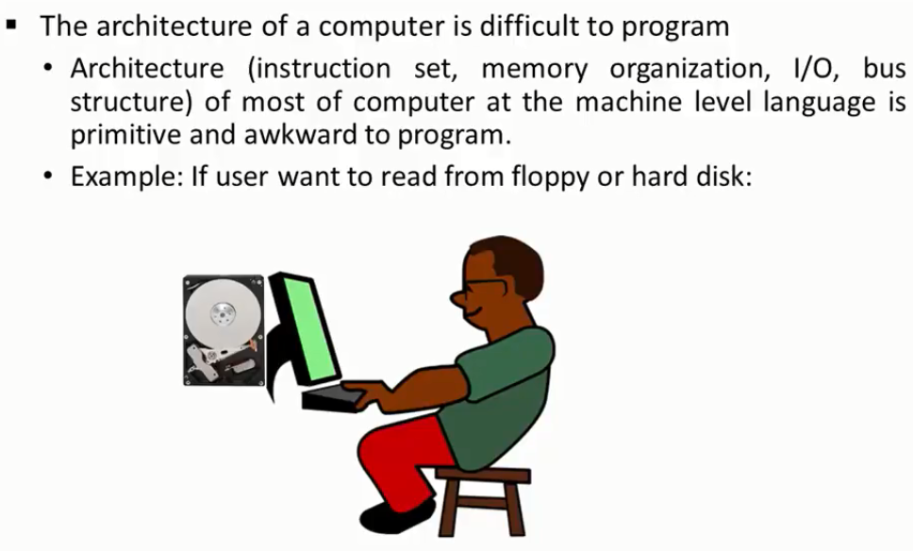
Example and discussion on :- The Operating System as an Extended Machine

Slide 8
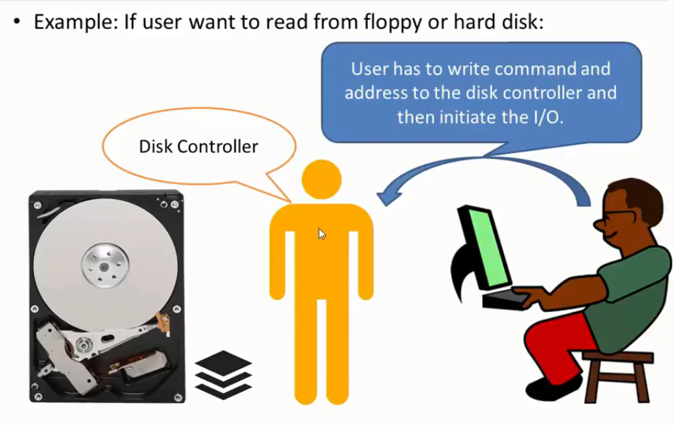
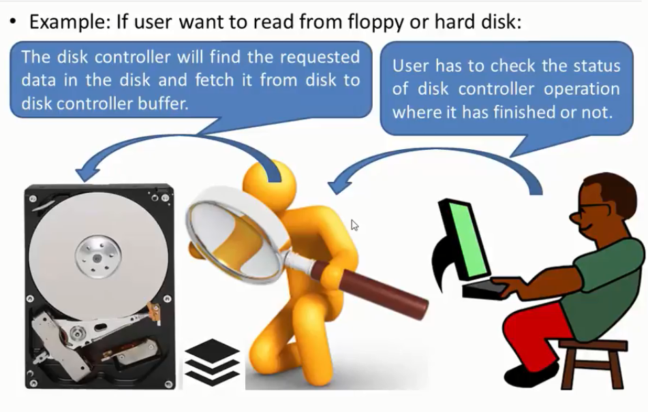

Slide 9
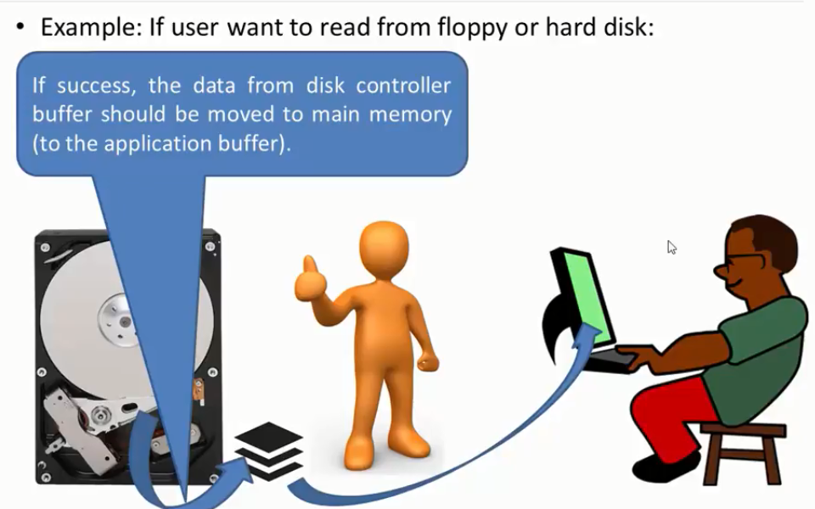

Slide 10
OS as a resource manager
The concept of an operating system as primarily providing abstractions to application programs is a top-down view.
In the bottom-up view, the job of the operating system is to provide for an orderly and controlled allocation of the processors, memories, and I/O devices among the various programs wanting them.
Modern operating systems allow multiple programs to be in memory and run at the same time.
For example: Imagine what would happen if three programs running on some computer all tried to print their output simultaneously on the same printer. The first few lines of printout might be from program 1, the next few from program 2, then some from program 3, and so forth. The result would be utter chaos. The operating system can bring order to the potential chaos by buffering all the output destined for the printer on the disk. When one program is finished, the operating system can then copy its output from the disk file where it has been stored for the printer, while at the same time the other program can continue generating more output, oblivious to the fact that the output is not really going to the printer (yet).

Slide 11
Resource management includes multiplexing (sharing) resources in two different ways: in time and in space.
When a resource is time multiplexed, different programs or users take turns using it. First one of them gets to use the resource, then another, and so on.
For example, with only one CPU and multiple programs that want to run on it, the operating system first allocates the CPU to one program, then, after it has run long enough, another program gets to use the CPU, then another, and then eventually the first one again. Determining how the resource is time multiplexed—who goes next and for how long—is the task of the operating system.
The other kind of multiplexing is space multiplexing. Instead of the customers taking turns, each one gets part of the resource.
For example, main memory is normally divided up among several running programs, so each one can be resident at the same time (for example, in order to take turns using the CPU). Assuming there is enough memory to hold multiple programs, it is more efficient to hold several programs in memory at once rather than give one of them all of it, especially if it only needs a small fraction of the total.

Slide 12
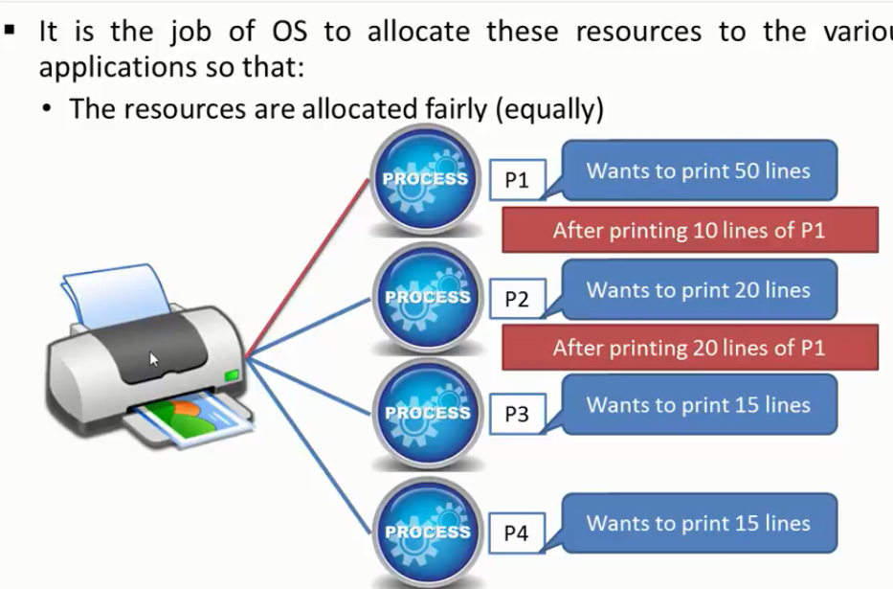

Slide 13
Types of operating system
Mainframe, Server, Multiprocessor, PC, Real-Time, Embedded, Smart Card Operating Systems

Slide 14
Mainframe operating system
These computers differ from personal computers in terms of their I/O capacity.
Mainframes are also making something of a comeback as high-end Web servers, servers for large-scale electronic commerce sites, and servers for business-to-business transactions.
The operating systems for mainframes are heavily oriented toward processing many jobs at once, most of which need prodigious amounts of I/O. They typically offer three kinds of services: batch, transaction processing, and timesharing.
A batch system is one that processes routine jobs without any interactive user present. Claims processing in an insurance company or sales reporting for a chain of stores is typically done in batch mode.
Transaction processing systems handle large numbers of small requests, for example, check processing at a bank or airline reservations. Each unit of work is small, but the system must handle hundreds or thousands per second.
Timesharing systems allow multiple remote users to run jobs on the computer at once, such as querying a big database.
An example mainframe operating system is OS/390, a descendant of OS/360. However, mainframe operating systems are gradually being replaced by UNIX variants such as Linux.

Slide 15
Server operating system
One level down are the server operating systems.
They run on servers, which are either very large personal computers, workstations, or even mainframes.
They serve multiple users at once over a network and allow the users to share hardware and software resources.
Servers can provide print service, file service, or Web service.
Internet providers run many server machines to support their customers and Websites use servers to store the Web pages and handle the incoming requests.
Typical server operating systems are Linux and Windows Server 200x.

Slide 16
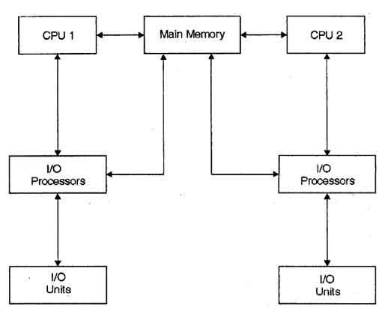
Multiprocessor operating system
Multiprocessor Operating System refers to the use of two or more central processing units (CPU) within a single computer system. These multiple CPUs are in a close communication sharing the computer bus, memory and other peripheral devices.
These types of systems are used when very high speed is required to process a large volume of data. These systems are generally used in environment like satellite control, weather forecasting etc. The basic organization of multiprocessing system is shown in fig.

Slide 17
Multiprocessing system is based on the symmetric multiprocessing model, in which each processor runs an identical copy of operating system and these copies communicate with each other.
The main advantage of multiprocessor system is to get more work done in a shorter period of time. Moreover, multiprocessor systems prove more reliable in the situations of failure of one processor. In this situation, the system with multiprocessor will not halt the system; it will only slow it down.

Slide 18
Personal computer operating system
The next category is the personal computer operating system.
Personal computer support multiprogramming, often with dozens of programs started up at boot time.
Their job is to provide good support to a single user. They are widely used for word processing, spreadsheets, and Internet access.
Common examples are Linux, FreeBSD, Windows Vista, and the Macintosh operating system. Personal computer operating systems are so widely known that probably little introduction is needed. In fact, many people are not even aware that other kinds exist.

Slide 19
Real-time operating system
Another type of operating system is the real-time system. These systems are characterized by having time as a key parameter.
If the action absolutely must occur at a certain moment (or within a certain range), we have a hard real-time system. Many of these are found in industrial process control, avionics, military, and similar application areas. These systems must provide absolute guarantees that a certain action will occur by a certain time.
Another kind of real-time system is a soft real-time system, in which missing an occasional deadline, while not desirable, is acceptable and does not cause any permanent damage. Digital audio or multimedia systems fall in this category. Digital telephones are also soft real-time systems.
For example, in industrial process control systems, real-time computers have to collect data about the production process and use it to control machines in the factory. Often there are hard deadlines that must be met.
For example, if a car is moving down an assembly line, certain actions must take place at certain instants of time. If a welding robot welds too early or too late, the car will be ruined.

Slide 20
Embedded operating system
Embedded systems run on the computers that control devices that are not generally thought of as computers and which do not accept user-installed software.
Typical examples are microwave ovens, TV sets, cars, DVD recorders, cell phones, MP3 players.
The main property which distinguishes embedded systems from handhelds is the certainty that no untrusted software will ever run on it.
You cannot download new applications to your microwave oven—all the software is in ROM.
This means that there is no need for protection between applications, leading to some simplification Systems such as QNX and VxWorks are popular in this domain.

Slide 21
Smart card operating system
The smallest operating systems run on smart cards, which are credit card sized devices containing a CPU chip.
They have very severe processing power and memory constraints.
Some are powered by contacts in the reader into which they are inserted, but contactless smart cards are inductively powered, which greatly limits what they can do.
Some of them can handle only a single function, such as electronic payments, but others can handle multiple functions on the same smart card. Often these are proprietary systems.
Some smart cards are Java oriented. What this means is that the ROM on the smart card holds an interpreter for the Java Virtual Machine (JVM).

Slide 22
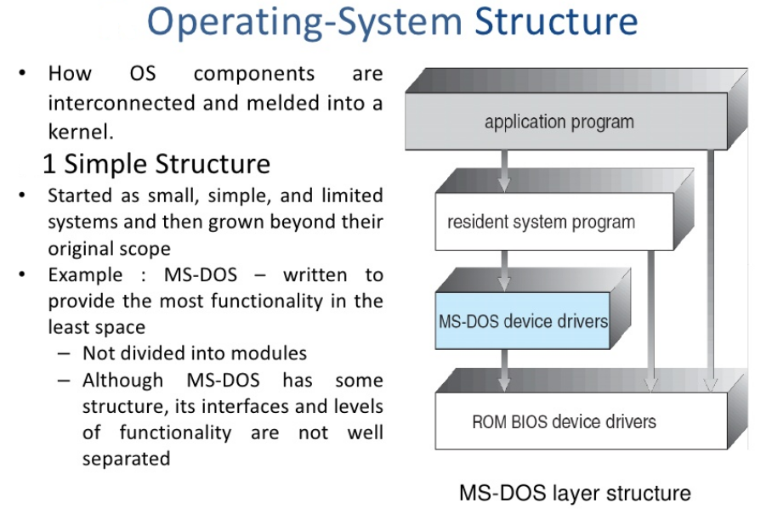
1

Slide 23
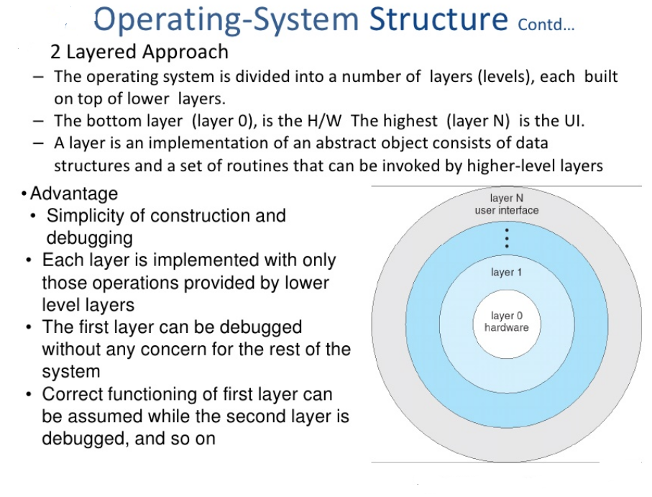
2

Slide 24
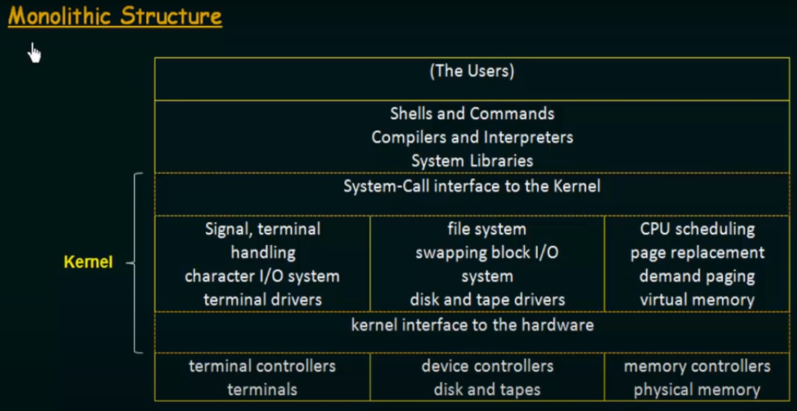
3

Slide 25
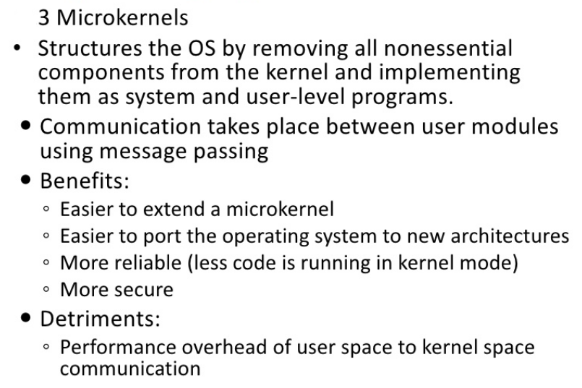
4
Due to message passing

Slide 26
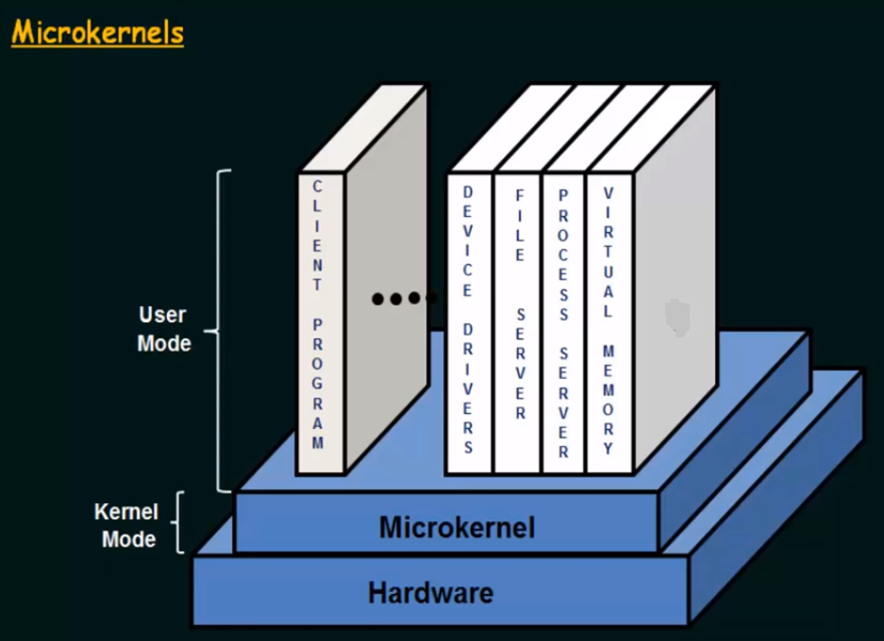

Slide 27
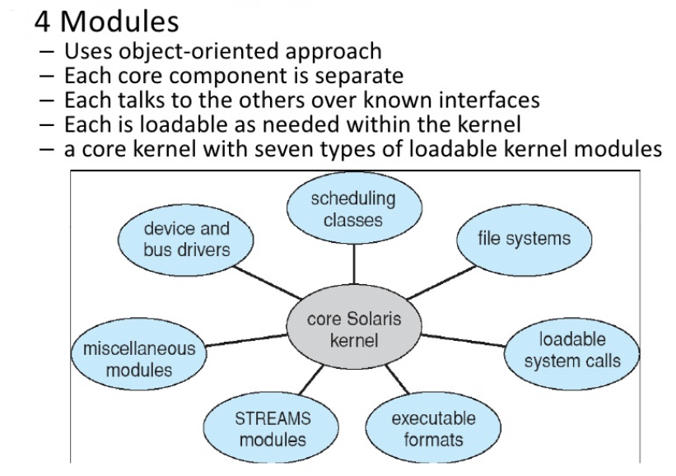
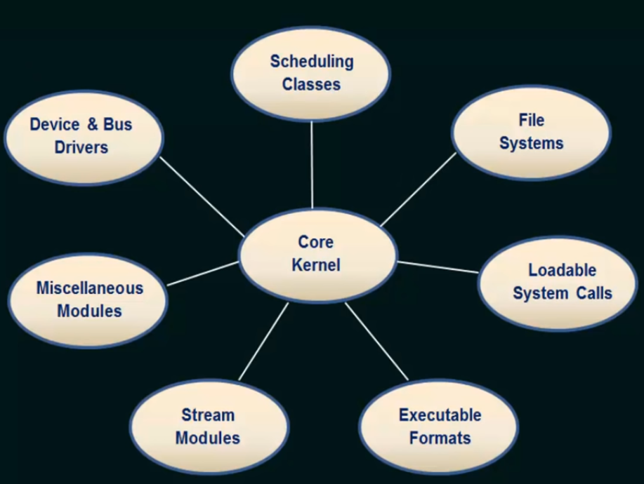
5

Slide 28
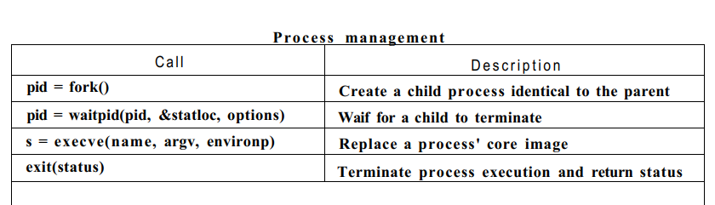
System Call
System call is the programmatic way in which a computer program requests a service from the kernel of the operating system.
Some kinds of system calls:
Process management
File management
Directory management
Process management
end, abort
Load , execute
Create process, terminate process
Get process attributes, set process attributes
Main()
{
fork();
Printf (“hello”);
}
P
C P
HELLO HELLO

Slide 29
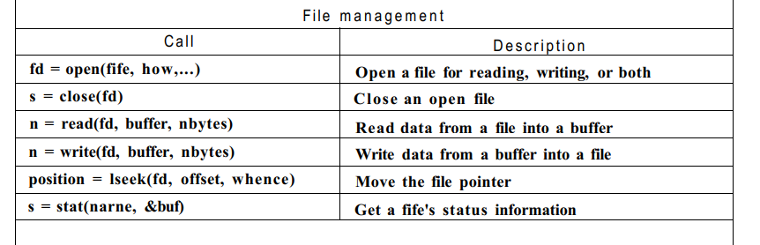
File management
Create file, delete file
Open, close
Read, write
Get file attributes, set file attributes

Slide 30
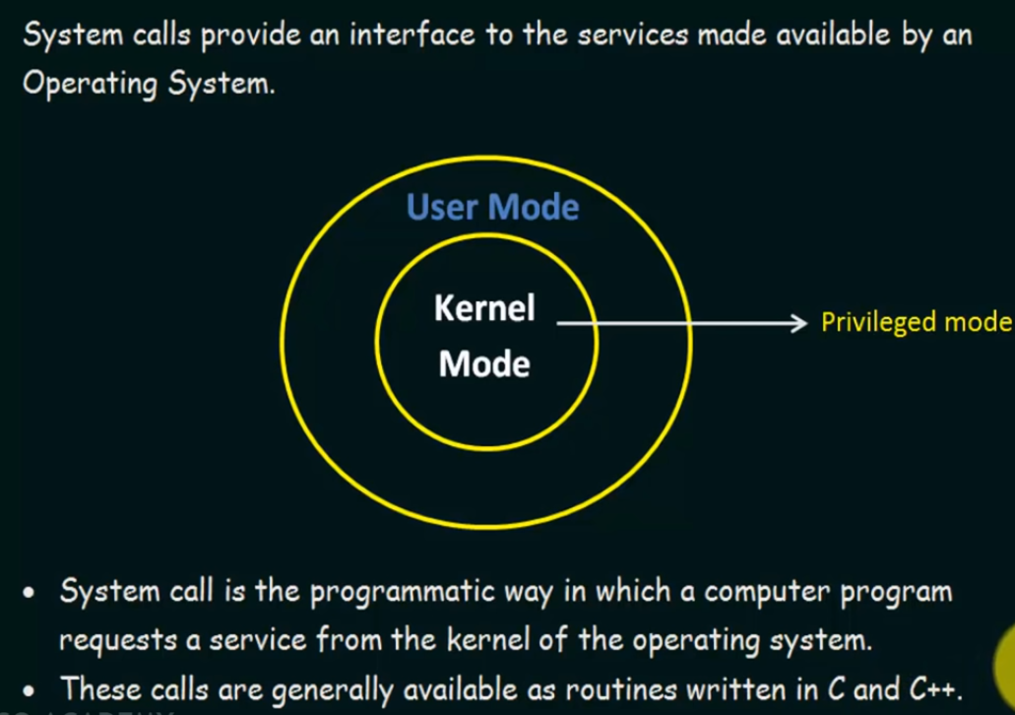

Slide 31
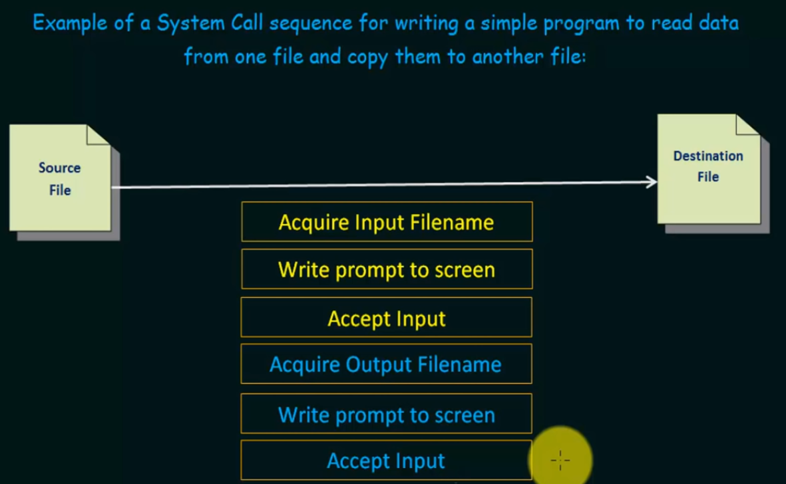

Slide 32
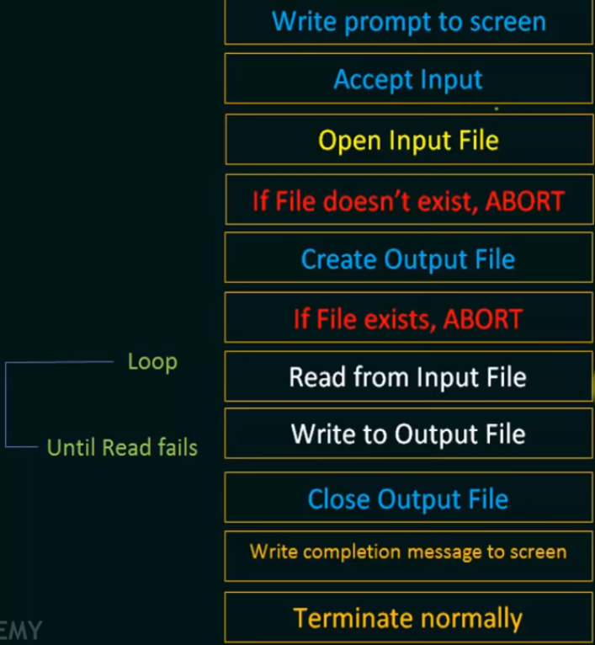

Slide 33
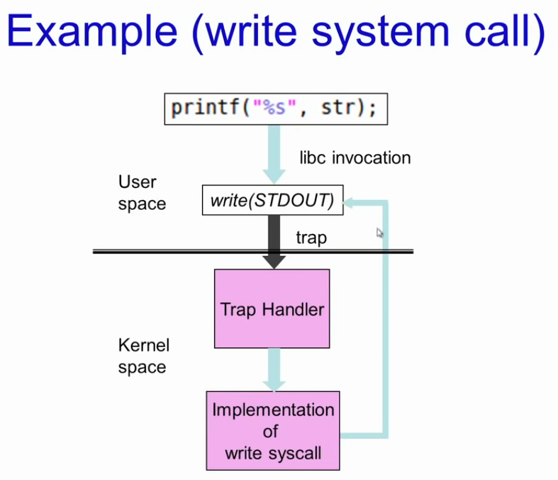

Slide 34
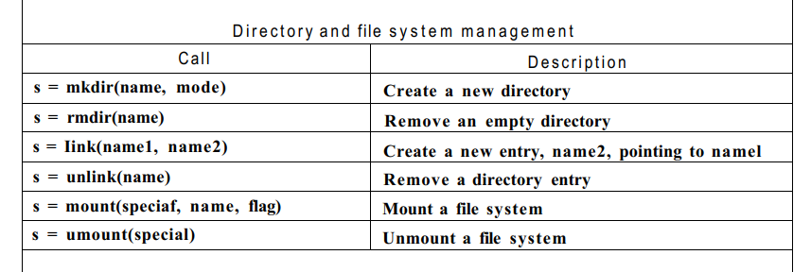
Directory management
In this section we will look at some system calls that relate more to directories or the file system as a whole, rather than just to one specific file as in the previous section.
The first two calls, mkdir and rmdir, create and remove empty directories, respectively.
The next call is link. Its purpose is to allow the same file to appear under two or more names, often in different directories.
A typical use is to allow several members of the same programming team to share a common file, with each of them having the file appear in his own directory, possibly under different names

Slide 35
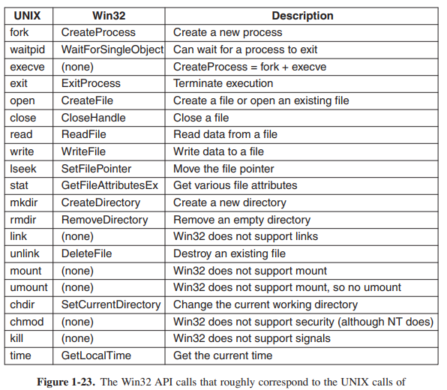

Slide 36
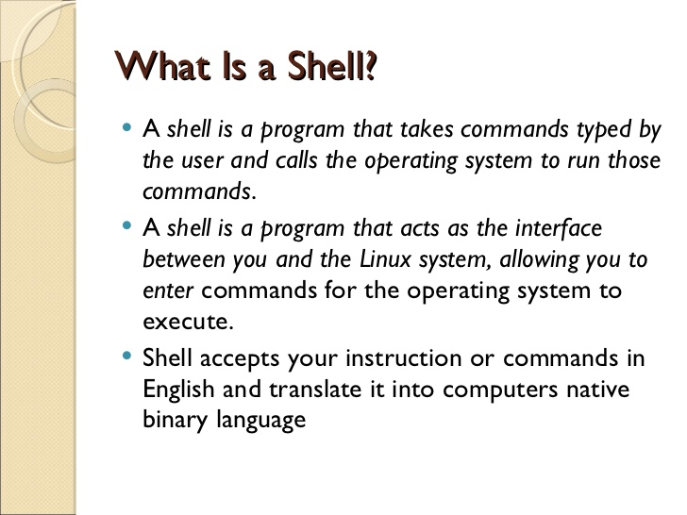

Slide 37
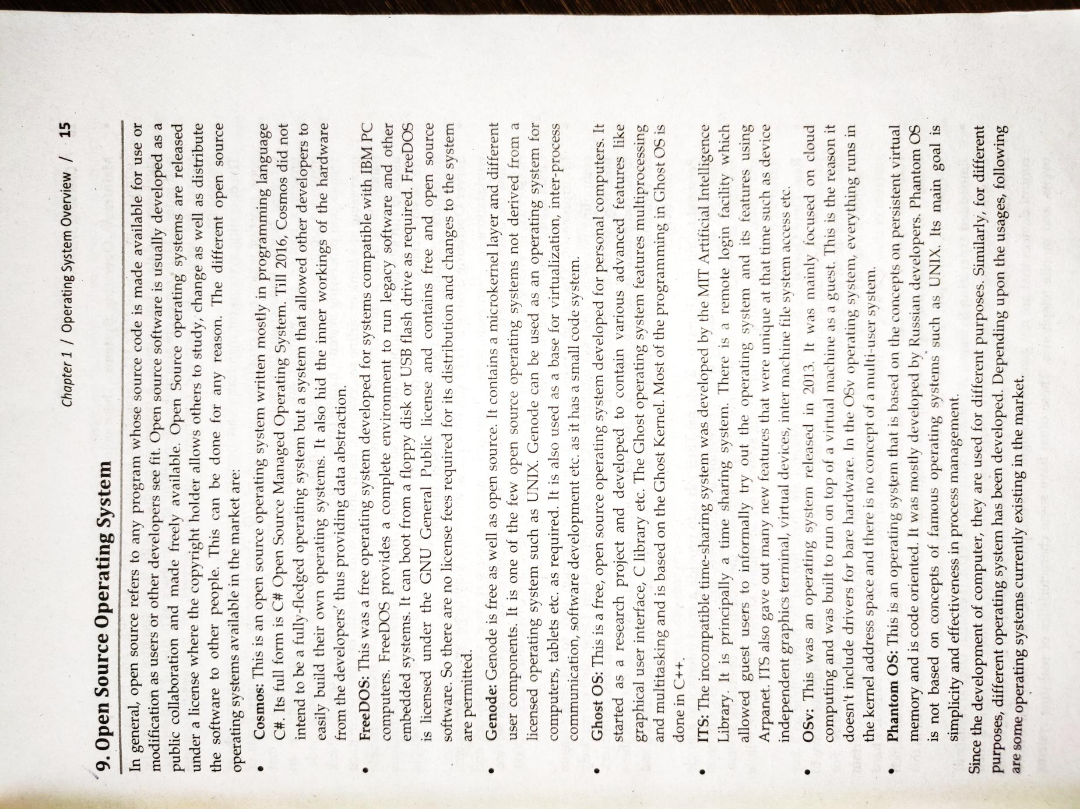

Slide 38
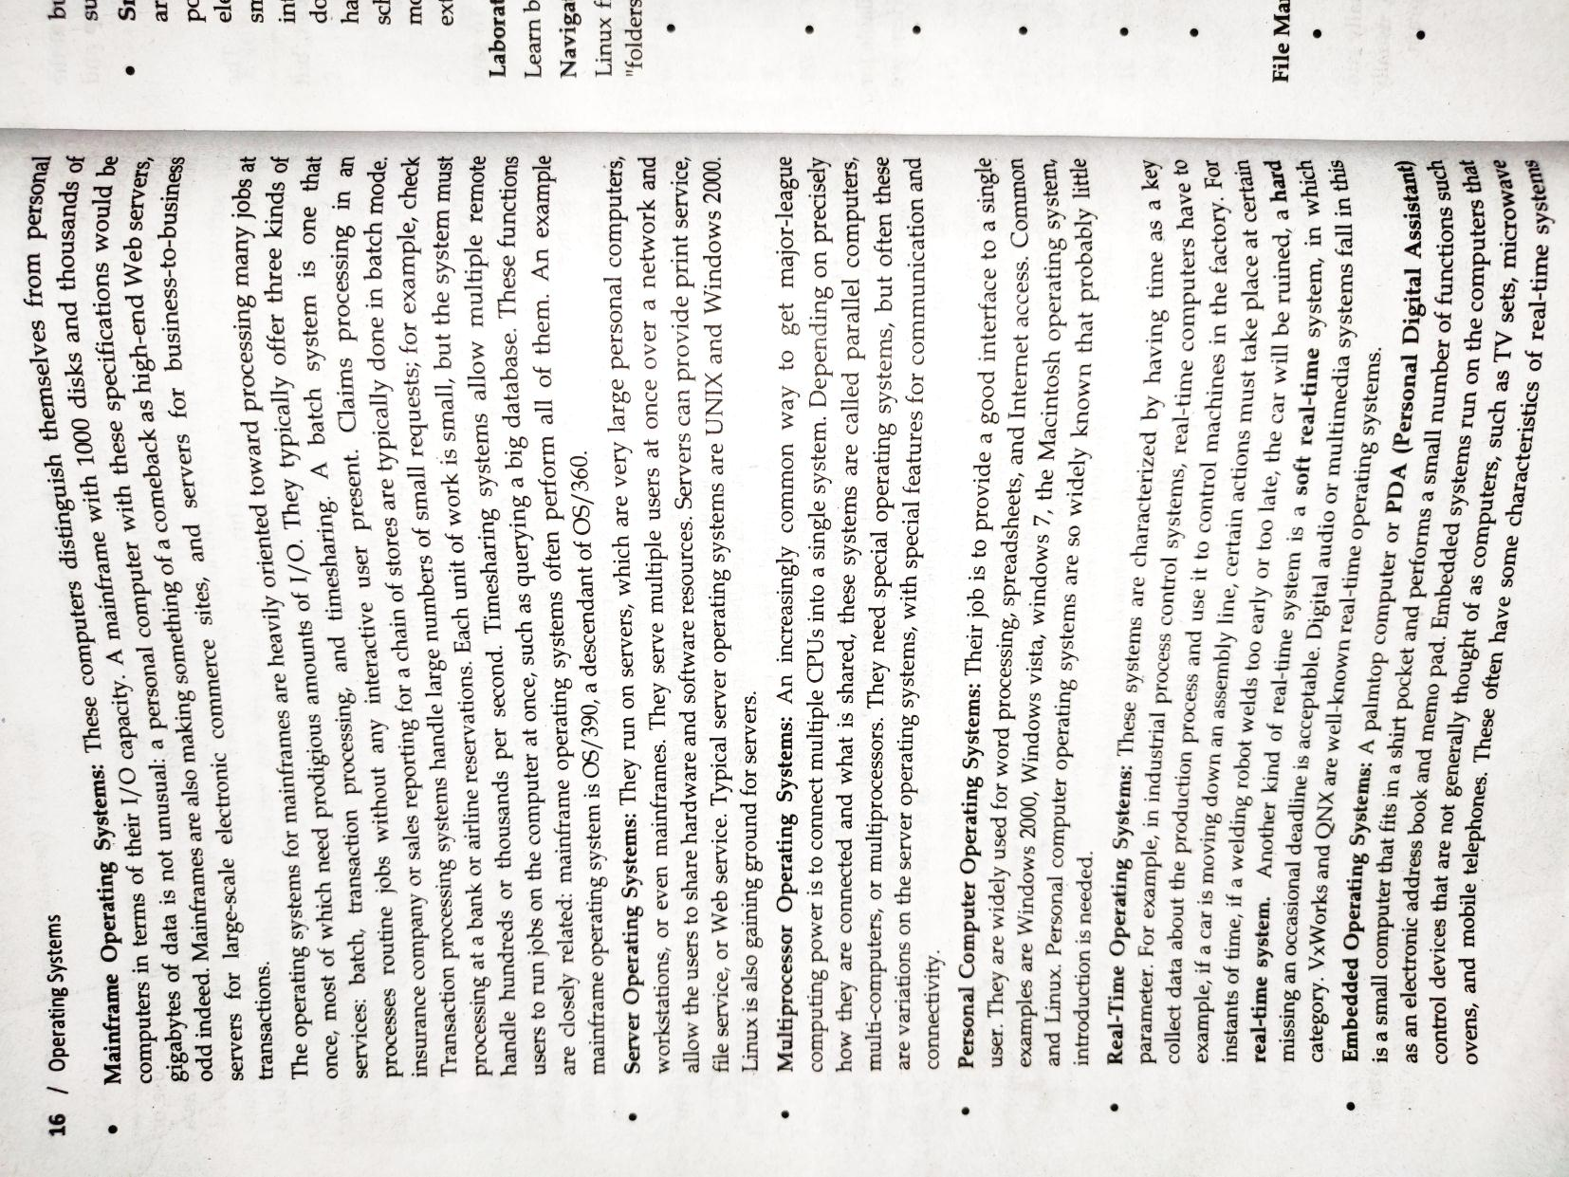

Slide 39
